Slide 1
Squarespace Twitter Support - Case Study
Greg Sikorsky Dec, 17 2024

Slide 2
Outline of Case Study Presentation
Theorized key success metrics for Twitter Customer Support
Displayed how other companies are currently performing given these metrics
Provide targets to strive for and recommendations for KPI goals given current landscape
State limitations of the research presented
Present demo dashboard for a Squarespace customer support Twitter account

Slide 3
Metric 1 - Average Response time
∑ ( Response Time for Each Inbound Tweet)
Average Response Time = ____________________________________________________________
Total Number of Inbound Tweets
Definition - the average time between when a customer sends a tweet and when the company responds.
Response time for each tweet is the difference between the timestamp of the inbound tweet and the timestamp of the response tweet from the support account.
Goal - The faster the response time the better the customer experience. The goal is to lower the response time to a feasible rate which is also acceptable given customer satisfaction.

Slide 4
Metric 2 - Average Resolution Time
∑ ( Resolution Time for Each Inbound Request)
Average Resolution Time = ____________________________________________________________
Total Number of Inbound Requests
Definition - the average time between when a customer sends a tweet and when the company responds.
Resolution time for each conversation is the difference between the timestamp of the last tweet in the conversation and the first inbound tweet.
Assumption - Once there are no more customer tweets in the same chain the issue has been resolved
Goal - The quicker the request is resolved the better the customer experience. Similarly to response time, the goal is to lower the resolution time to a feasible number which is also acceptable given customer satisfaction.

Slide 5
Metric 3 - Average Interactions per Conversation
∑ (Average Number of Tweets per Conversation)
Average Interactions per Conversation = ____________________________________________________________
Total Number of Conversations
Definition - the average number of exchanges between the customer and the company within given support interaction on Twitter.
For each conversation, count the number of tweets between customer and company.
Goal - Fewer interactions to achieve quicker resolutions and less back and forth.

Slide 6
Metric 4 - Average Customer Sentiment
∑ (Sentiment Score)
Average Customer Sentiment = ____________________________________________________________
Total Number of Tweets
Definition - the mean of the sentiment scores of all tweets by customers. Idea is to gauge overall customer satisfaction via tweet text analysis.
A positive sentiment score is closer to 1 and a negative sentiment score is closer to -1.
0 is a neutral sentiment score.
Goal - Achieve a higher sentiment score showing customers are more satisfied.

Slide 7
Theoretical Recommendations
Overall Goal - I would recommend that the goal for Squarespace’s Twitter Support Account should be to be in at least the 75th to 80th percentile for all for the metrics listed.
Let’s further examine the data to create a company by company analysis.
We will find the actual numbers that would have to be achieved to meet the stated goal.

Slide 8
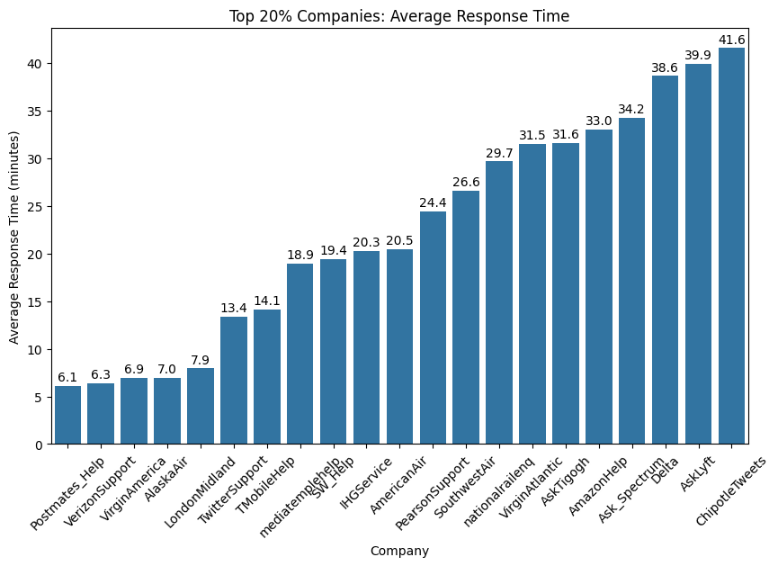
Company Analysis - Average Response Time

Slide 9
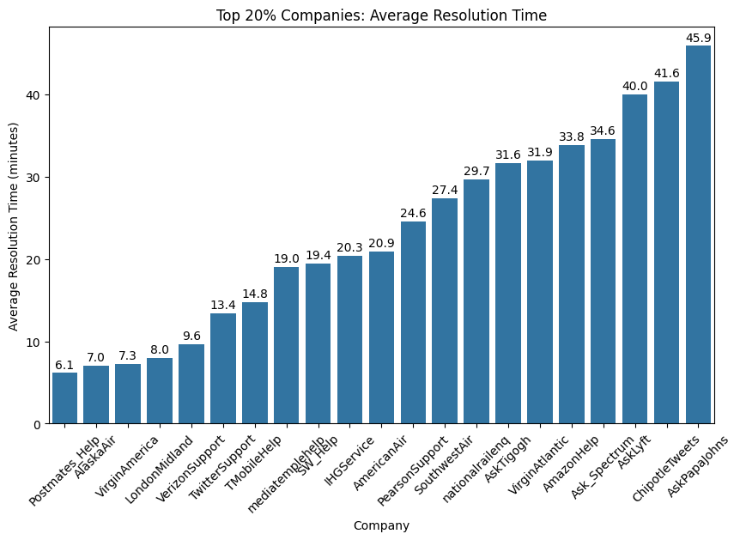
Company Analysis - Average Resolution Time

Slide 10
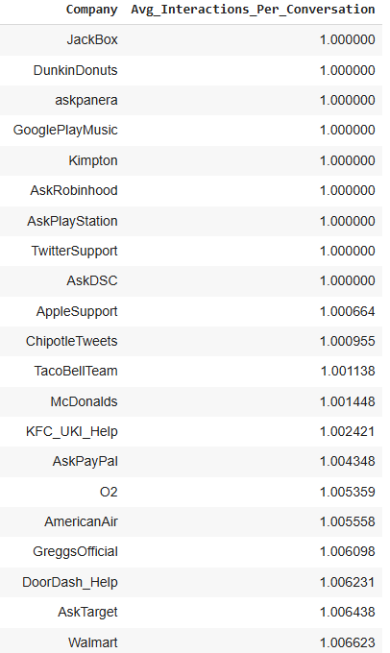
Company Analysis -
Average Interactions
per Conversation in the top 20th percentile

Slide 11
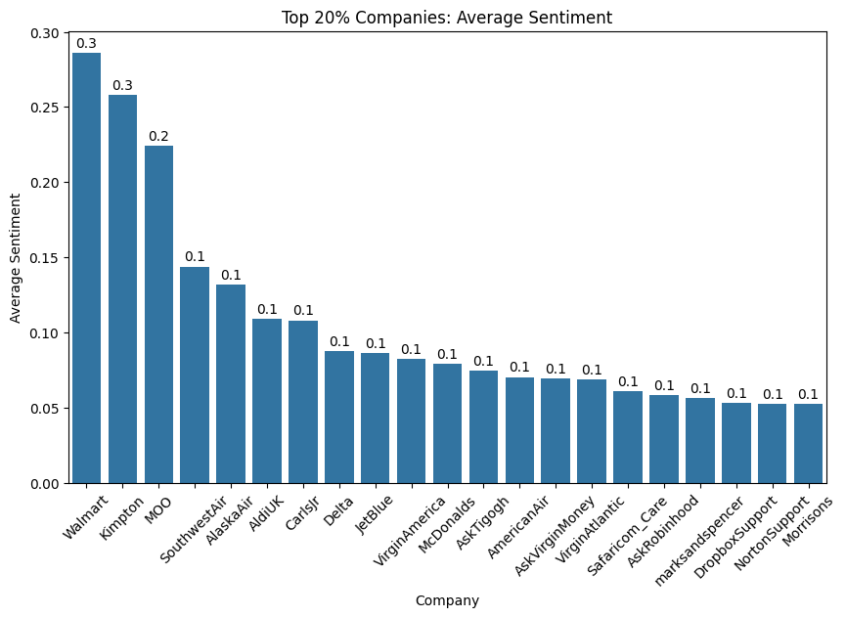
Company Analysis - Average Customer Sentiment

Slide 12
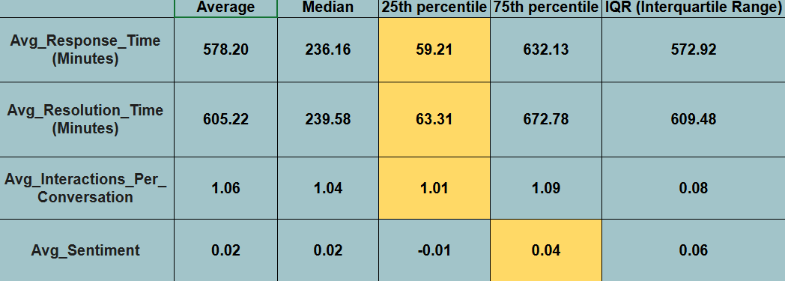
Industry Wide Statistics Across all Companies
Below are key descriptive statistics for these 4 metrics across all companies.
Highlighted in yellow are recommendations for Squarespace’s twitter account to meet given the current landscape

Slide 13
KPI Recommendations to be met for
Squarespace Twitter Account
Average response time - Given the 25th percentile for response time is 59.2 minutes the recommendation would be to achieve at most an average response time of approximately 59 minutes.
Average resolution time - Given the 25th percentile for response time is 63.3 minutes, the recommendation would to be achieve at most an average resolution time of approximately 63 minutes.
Average Interaction per Conversation - Given the 25th percentile for interactions per conversation is 1.01, achieving as close to the number or lower as possible would be the recommendation.
Average Customer Sentiment - Given the 75th percentile for customer sentiment score is 0.04, the recommendation would be to achieve at least a sentiment score of 0.04.

Slide 14
Limitations of Data & Corresponding Analysis
Sentiment Analysis - The accuracy of the sentiment analysis can certainly be in question given the nature of the platform (Twitter) and the brevity/lack of clarity people typically communicate with on said platform. Tweets are often brief and contain slang. Users are also more likely to be unhappy given they are interacting with a support account.
Average Response Time - Automated responses will certainly drive this number down even despite a customer perhaps not necessarily receiving the help they need.
Average Resolution Time - Assuming that since there are no more tweets in the interaction means the query has been solved can be questionable. The customer may not be truly satisfied.
Average Interactions per Conversation - Clearly, the data is heavily skewed toward single response tweets. The average number of tweets in each conversation across the entire data set was 1.06. People clearly do not typically interact with support accounts for more than one initial tweet. Some reasons could be: response came from bot, response asked to send a DM instead, etc. In addition, similar to resolution time, there could be additional follow up that is not accounted for in a single tweet chain.

